Slide 1

Interaction Design 2024
Group Presentations: ~2 mins per group

Slide 2
Group 5

Slide 3


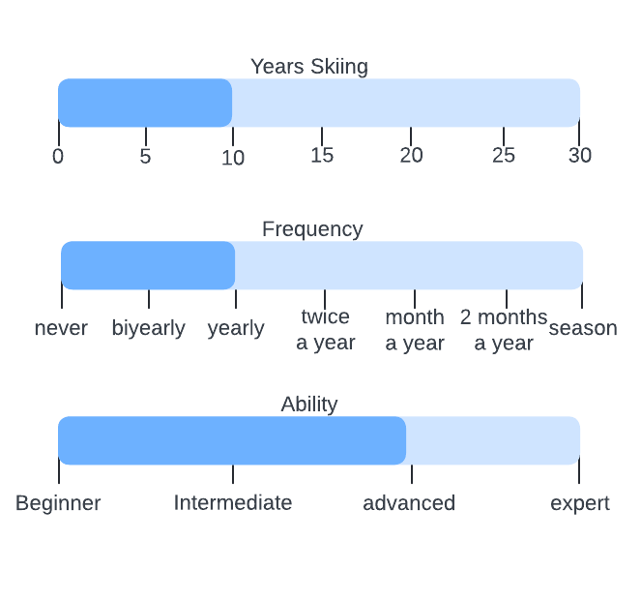
Target User Group
Skiers and snowboarders of all levels!

Slide 4
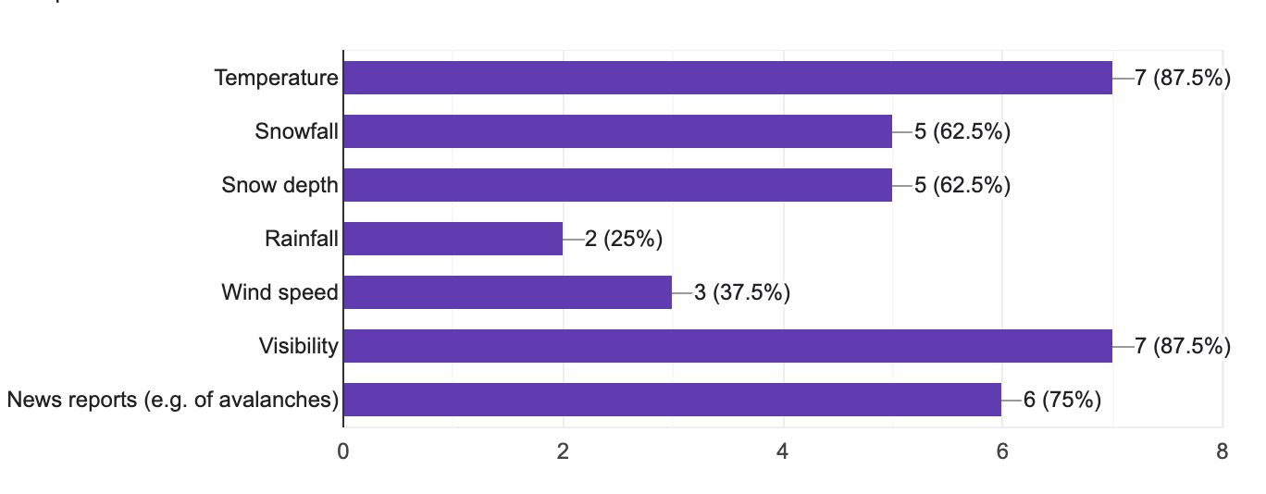
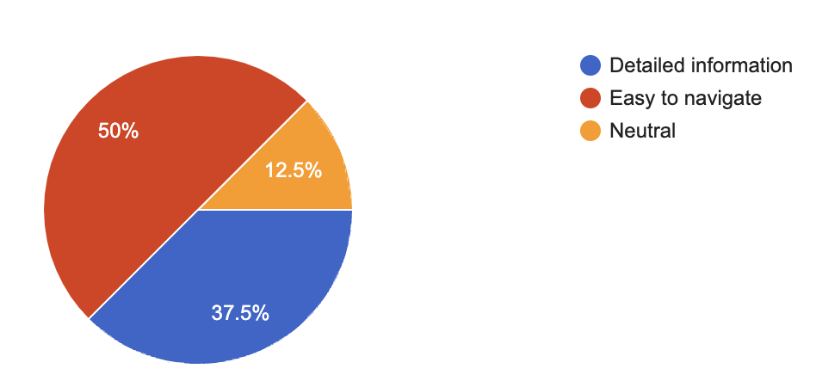
User Research
Questionnaire
Interviews
Studying Documentation

Slide 5
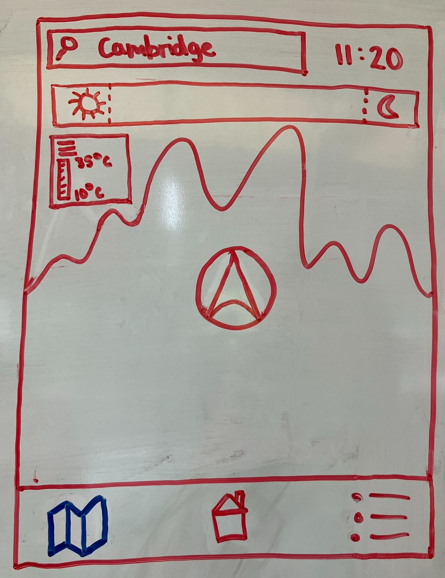
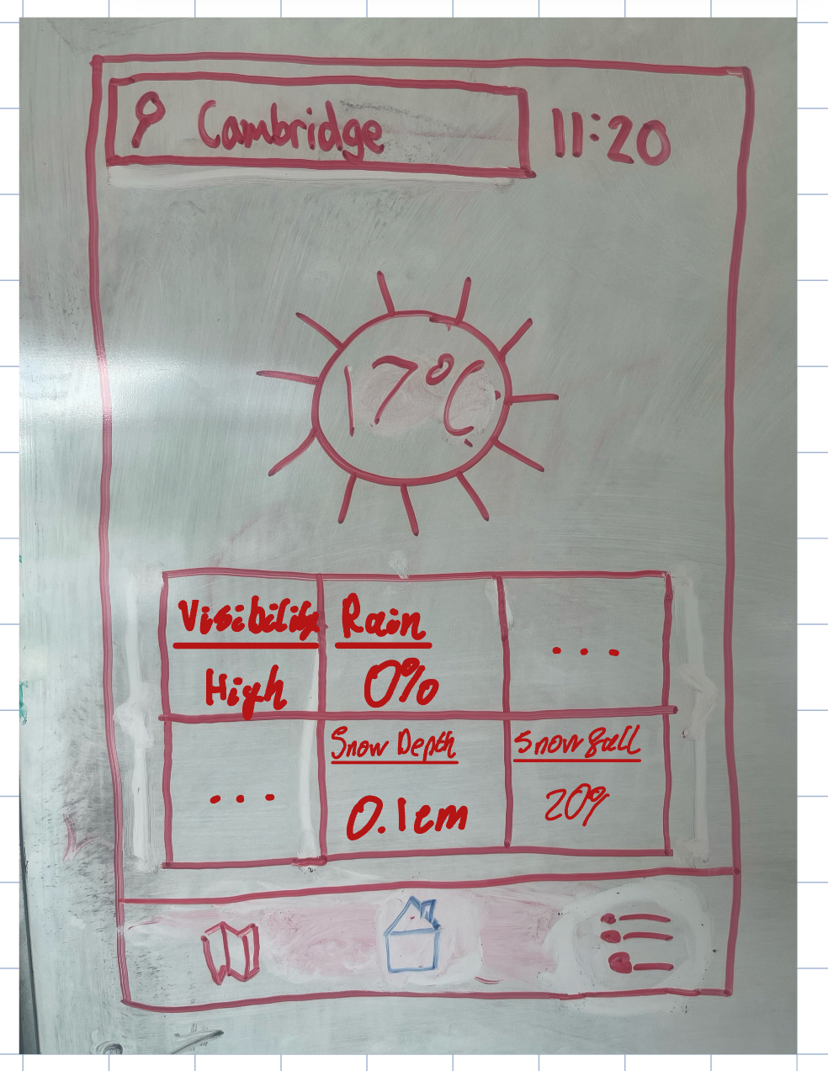
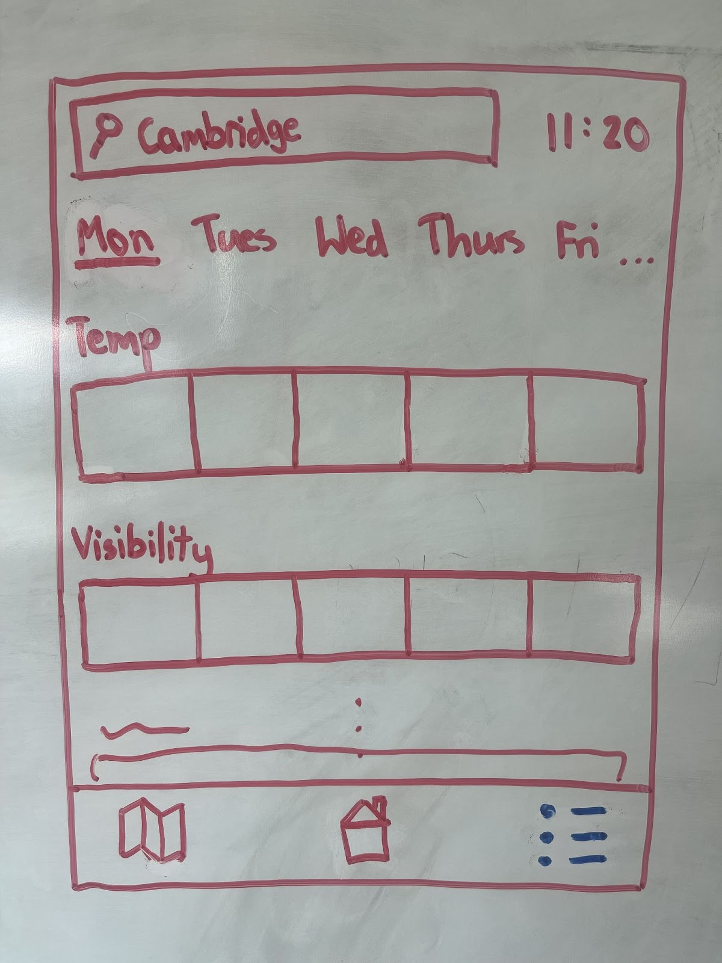
Design

Slide 6
Hi-Fi Prototype

Slide 7
Limitations and Further Improvements

